Slide 1

OOP – Good Practices

Slide 2

SOLID

Slide 3
S – Single Responsibility Principle
Do one thing, but do it good!

Slide 4
O – Open for extensions, closed for modifications!

Slide 5
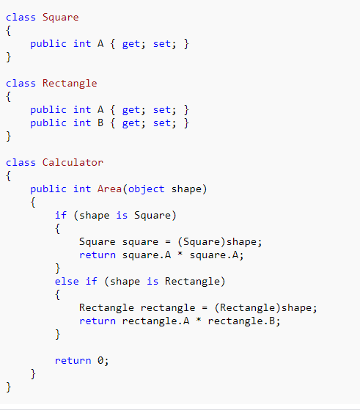
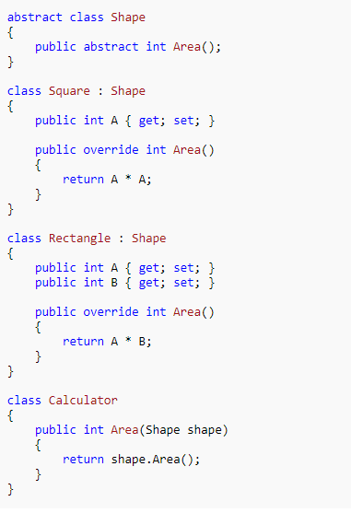
vs

Slide 6
L – Liska Boskov substitution Principle
Your code should work correctly with the class and all its subclasses!

Slide 7
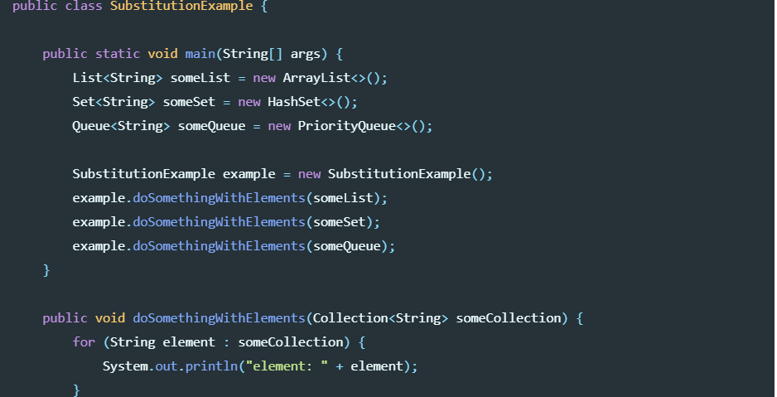

Slide 8
I – Interface Segregation principle
Interfaces should be small and specific so that classes do not implement methods they do not need!

Slide 9
I – Dependency Inversion Principle
A. High-level modules should not depend on low-level modules. Both should depend on abstractions. B. Abstractions should not depend on details. Details should depend on abstractions

Slide 10
Design Patterns - Overview
In software engineering, a software design pattern is a general, reusable solution to a commonly occurring problem within a given context in software design.

Slide 11
DTO – Data Transfer Object
Data Transfer Object pattern is used when we want to pass data with multiple attributes in one shot from client to server. Transfer object is also known as Value Object. Transfer Object is a simple POJO class having getter/setter methods and is serializable so that it can be transferred over the network.

Slide 12
DAO – Data Access Object
It is a object/interface, which is used to access data from database of data storage.

Slide 13
MVVM –Model –View - ViewModel
Model-View-ViewModel (MVVM) is a structural design pattern that separates objects into three distinct groups:
Models hold application data. They’re usually structs or simple classes.
Views display visual elements and controls on the screen. They’re typically subclasses of UIView.
ViewModels transform model information into values that can be displayed on a view. They’re usually classes, so they can be passed around as references.

Slide 14
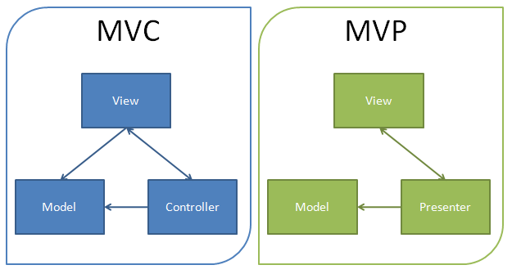
MVP –Model –View - Presenter
Architectural Design Pattern created to divide data domain and presentation layer

Slide 15
Repository Pattern
It is an abstraction of the data layer
It is a way of centralising the handling of the domain objects

